Slide 1

Unit-3 Inheritance and Abstraction
Object-Oriented Programming
2305CS102
Prof. Swati R Sharma
Computer Engineering Department
swati.sharma@darshan.ac.in

Slide 2
Syllabus
Sr. | Content | T Hrs | W %
1 | Introduction to JAVA | 10 | 20
2 | Object Oriented Concepts | 15 | 22
3 | Inheritance and Abstraction | 12 | 20
4 | Package, Exception Handling and Multithreading | 13 | 20
5 | IO Programming and Collection Framework | 10 | 18

Slide 3
Unit-3

Looping
What we will learn
Use of Inheritance
Inheriting data members
Types of Inheritance
Overriding Methods and Constructor
Super keyword
Final keyword
Abstract class
Interface
Dynamic Method Dispatch

Slide 4

Inheritance
Hierarchical Classification

Slide 5

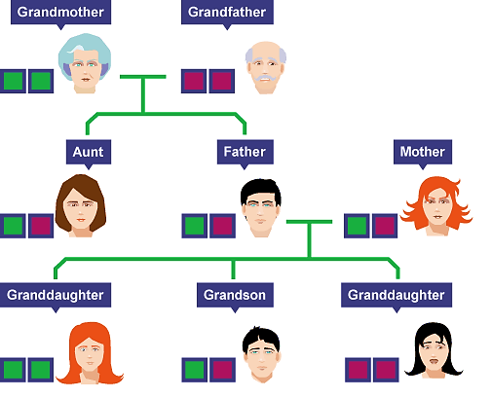
Inheritance

Slide 6
Inheritance
Definition-1: “The mechanism of a class to derive properties and characteristics from another class is called Inheritance. “
Definition-2: “Inheritance is the process, by which class can acquire(reuse) the properties and methods of another class.”
It is the most important feature of Object Oriented Programming.
Base Class: The class whose properties are inherited by sub class is called Base Class/Super class/Parent class.
Derived Class: The class that inherits properties from another class is called Sub class/Derived Class/Child class.
Inheritance is implemented using super-class and sub-class relationship in object-oriented languages.
Base Class
Derived Class

Slide 7
Inheritance
Inheritance is also known as “IS-A relationship” between parent and child classes.
For Example :
Car IS A Vehicle
Bike IS A Vehicle
EngineeringCollege IS A College
MedicalCollege IS A College
MCACollege IS A College

Slide 8
Inheritance
class Doctor
class Footballer
class Businessman
Attributes:
Age, Height, Weight
Methods:
Talk()
Walk()
Eat()
Diagnose()
Attributes:
Age, Height, Weight
Methods:
Talk()
Walk()
Eat()
Playfootball()
Attributes:
Age, Height, Weight
Methods:
Talk()
Walk()
Eat()
Runbusiness()
All of the classes have common attributes (Age, Height, Weight) and methods (Walk, Talk, Eat).
However, they have some special skills like Diagnose, Playfootball and Runbusiness.
In each of the classes, you would be copying the same code for Walk, Talk and Eat for each character.

Slide 9
Inheritance
class Person is called Base class
class Person
Attributes:
Age, Height, Weight
Methods:
Talk() , Walk(), Eat()
class Doctor
class Footballer
class Businessman
Methods:
Diagnose()
Methods:
Playfootball()
Methods:
Runbusiness()
These classes are called Derived class

Slide 10
Inheritance
class Vehicle
Attributes:
Engine_no, color
Methods:
apply_breaks()
class Car
class Bus
class Truck
Attributes:
Private_vehicle
Attributes:
Public_vehicle
Attributes:
Goods_vehicle

Slide 11
Inheritance: Advantages
Promotes reusability
When an existing code is reused, it leads to less development and maintenance costs.
It is used to generate more dominant objects.
Avoids duplicity.
Inheritance makes the sub classes follow a standard interface.
Base Class
Derived Class

Slide 12

Implementing Inheritance
Subclass-Superclass Relationship

Slide 13
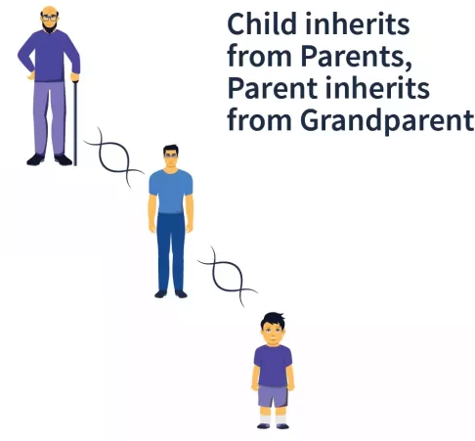
Inheritance Example

Slide 14
How to implement Inheritance in java
To inherit a class, you simply incorporate the definition of one class into another by using the extends keyword.
Syntax:
class subclass-name extends superclass-name {
// body of class…
}

Slide 15
Implementing Inheritance in java
class A
{
//SuperClass or ParentClass or BaseClass
}
Class A
Base Class
the keyword “extends” is used to create a subclass of A
class B extends A
{
//SubClass or ChildClass or DerivedClass
}
Class B
Derived Class

Slide 16
Implementing Inheritance in java
class Person
{
String name;
long contact;
}
class Employee extends Person
{
int empID;
String designation;
}
class Customer extends Person
{
int customerID;
int invoiceNo;
}
Person
name:String Contact:long
Employee
empID:int Designation:String
Customer
customerID:int InvoiceNo:int

Slide 17
Implementing Inheritance in java
class Person
{
String name;
long contact;
public void dispContact()
{ System.out.println(“num=”+contact);
}
}
class Employee extends Person
{
int empID;
String designation;
}
Class Customer extends Person
{
int customerID;
int invoiceNo;
}
Person
name:String Contact:long
dispContact():void
Employee
empID:int Designation:String
Customer
customerID:int InvoiceNo:int

Slide 18
Property of Inheritance

Slide 19
Property of Inheritance
A class member that has been declared as private will remain private to its class. It is not
accessible by any code outside its class, including subclasses.
Base class A can’t access attributes and methods of Derived Class B
Class A
Base Class
Derived Class B can’t access private members of Base class A
Class B
Derived Class
Derived Class B can access attributes and methods of Base class A

Slide 20
Inheritance by Example

Slide 21
Example1: InheritanceDemo1
A
#i:int ~j:int
showij():void
B
~k:int
showk():void add():void

Slide 22
Example1: InheritanceDemo.java
class A{
protected int i;
int j;
void showij(){
System.out.println("i="+i+" j="+j);
}
}
class B extends A{ //inheritance
int k;
void showk(){
System.out.println("k="+k);
}
void add(){ System.out.println("i+j+k="+(i+j+k));
}
}
class InheritanceDemo{
public static void main(String[] args)
{
A superObjA= new A();
superObjA.i=10;
superObjA.j=20;
B subObjB= new B();
subObjB.k=30;
superObjA.showij();
subObjB.showk();
subObjB.add();
}
}
Output
i=10 j=20
k=30
i+j+k=30

Slide 23
Types of Inheritance in Java
1. Single Inheritance
2. Hierarchical Inheritance
3. Multilevel Inheritance
A
A
A
B
B
C
B
C
4. Multiple Inheritance
5. Hybrid Inheritance
A
B
A
Note: Multiple and Hybrid Inheritance is not supported in Java with the Class Inheritance, we can still use those Inheritance with Interface which we will learn in later part of the Unit
B
C
C
D

Slide 24
Single Inheritance
A
B

Slide 25
Single Inheritance: InheritanceDemo.java
class A{
protected int i;
int j;
void showij(){
System.out.println("i="+i+" j="+j);
}
}
class B extends A{ //inheritance
int k;
void showk(){
System.out.println("k="+k);
}
void add(){ System.out.println("i+j+k="+(i+j+k));
}
}
class InheritanceDemo{
public static void main(String[] args)
{
A superObjA= new A();
superObjA.i=10;
superObjA.j=20;
B subObjB= new B();
subObjB.i=100
subObjB.j=100;
subObjB.k=30;
superObjA.showij();
subObjB.showk();
subObjB.add();
}
}
A
B
Output
i=10 j=20
k=30
i+j+k=230

Slide 26
Hierarchical Inheritance
A
B
C

Slide 27
class A{
protected int i;
int j;
void showij(){
System.out.println("inside class A:i="+i+" j="+j);
}
}
class B extends A{
int k;
void showk(){ System.out.println("inside class B:k="+k);
}
void add_ijk(){ System.out.println(i+"+"+j+"+"+ k+"="+(i+j+k));
}}
class C extends A{
int m;
void showm(){
System.out.println("inside class C:k="+m);
}
void add_ijm(){
System.out.println(i+"+"+j+ "+"+m+"="+(i+j+m));
}
}
A
B
C
InheritanceLevel.java

Slide 28
class InheritanceLevel{
public static void main(String[] args) {
A superObjA= new A();
superObjA.i=10;
superObjA.j=20;
superObjA.showij();
B subObjB= new B();
subObjB.i=100;
subObjB.j=200;
subObjB.k=300;
subObjB.showk();
subObjB.add_ijk();
C subObjC= new C();
subObjC.i=1000;
subObjC.j=2000;;
subObjC.m=3000;
subObjC.showm();
subObjC.add_ijm();
}
}
InheritanceLevel.java
A
B
C
Output
inside class A:i=10 j=20
inside class B:k=300
100+200+300=600
inside class C:k=3000
1000+2000+3000=6000

Slide 29
Multilevel Inheritance
A
B
C

Slide 30
class A{
protected int i;
int j;
void showij(){
System.out.println("inside class A:i="+i+" j="+j);
}
}
class B extends A{
int k;
void showk(){ System.out.println("inside class B:k="+k);
}
void add_ijk(){ System.out.println(i+"+"+j+"+"+ k+"="+(i+j+k));
}}
class C extends B{
int m;
void showm(){
System.out.println("inside class C:k="+m);
}
void add_ijkm(){
System.out.println(i+"+"+j+ "+"+k+"+"+m+"="+(i+j+k+m));
}
}
A
B
C
InheritanceMultilevel.java

Slide 31
class InheritanceMultilevel{
public static void main(String[] args) {
A superObjA= new A();
superObjA.i=10;
superObjA.j=20;
superObjA.showij();
B subObjB= new B();
subObjB.i=100;
subObjB.j=200;
subObjB.k=300;
subObjB.showk();
subObjB.add_ijk();
C subObjC= new C();
subObjC.i=1000;
subObjC.j=2000;
subObjC.k=3000;
subObjC.m=4000;
subObjC.showm();
subObjC.add_ijkm();
}
}
InheritanceMultilevel.java
A
B
C
Output
inside class A:i=10 j=20
inside class B:k=300
100+200+300=600
inside class C:k=4000
1000+2000+3000+4000=10000

Slide 32
Derived Class with Constructor

Slide 33
Derived Class with Constructor
Cube
# height: double # width: double # depth: double
Cube() volume(): double
CubeInherit
cw1:CubeWeight cw2:CubeWeight
main(): void
CubeWeight
# weigth: double
CubeWeight(double, double, double, double):double

Slide 34
class Cube{
protected double height,width,depth;
Cube(){
System.out.println("inside
default Constructor:CUBE");
}
double volume(){
return height*width*depth;
}
}
class CubeInherit{
public static void main(String[] args) {
CubeWeight cw1= new
CubeWeight(10,10,10,20.5);
CubeWeight cw2= new
CubeWeight(100,100,100,200.5);
System.out.println("cw1.volume()=" +cw1.volume());
System.out.println("cw2.volume()=" +cw2.volume());
}}
class CubeWeight extends Cube{
double weigth;
CubeWeight(double h,double w,double d, double m)
{
System.out.println("inside Constructor:
CUBEWEIGTH");
height=h;
width=w;
depth=d;
weigth=m;
}}
CubeInherit.java
Output
inside default Constructor:CUBE
inside Constructor:CUBEWEIGTH
inside default Constructor:CUBE
inside Constructor:CUBEWEIGTH
cw1.volume()=1000.0
cw2.volume()=1000000.0

Slide 35
Super Keyword

Slide 36
Super Keyword
Whenever a subclass needs to refer to its immediate superclass, it can do so by use of the keyword super. Super has two general forms:
Calls the superclass constructor.
Used to access a members(i.e. instance variable or method) of the superclass.

Slide 37
Using super to Call Superclass Constructors
Call to super must be first statement in constructor
Cube
# height: double # width: double # depth: double
volume(): double
CubeInherit
cw1:CubeWeight cw2:CubeWeight
main(): void
Using “super”
Cube(double, double, double)
CubeWeight
# weigth: double
CubeWeight(double, double, double, double)

Slide 38
class Cube{
protected double height,width,depth;
Cube(double h,double w,double d){
System.out.println("Constructor:
CUBE");
height=h;
width=w;
depth=d;
}
double volume(){
return height*width*depth;
}
}
class CubeInheritSuper{
public static void main(String[] args) {
CubeWeight cw1= new CubeWeight(10,10,10,20.5);
CubeWeight cw2= new CubeWeight(100,100,100,200.5);
System.out.println("cw1.volume()="+cw1.volume());
System.out.println("cw1.weigth="+cw1.weigth);
System.out.println("cw2.volume()="+cw2.volume());
System.out.println("cw2.weigth="+cw2.weigth);
}
}
CubeInheritSuper.java
Output
class CubeWeight extends Cube{
double weigth;
CubeWeight(double h,double w,double d, double m){
super(h,w,d); //call superclassConstructor
System.out.println("Constructor:CUBEWEIGTH");
weigth=m;
}
}
Constructor:CUBE
Constructor:CUBEWEIGTH
Constructor:CUBE
Constructor:CUBEWEIGTH
cw1.volume()=1000.0
cw1.weigth=20.5
cw2.volume()=1000000.0
cw2.weigth=200.5
Using super to Call Superclass Constructors

Slide 39
Using super to access members
The second form of super acts somewhat like this, except that it always refers to the superclass of the subclass in which it is used.
Syntax:
This second form of super is most applicable to situations in which member names of a subclass hide members by the same name in the superclass.
member can be either a method or an instance variable.
super.member

Slide 40
Using super to access members: SuperMemberDemo.java
class A{
}
class B extends A{
int i,k;
B(int a,int b){
this.i=b;
}
void show(){
System.out.println("super.i="+super.i);
System.out.println("this.i="+this.i);
}
}
class SuperMemberDemo{
public static void main(String[] args)
{
B b= new B(12,56);
b.show();
}
}
int i;
super.i=a;
Output
super.i=12
this.i=56

Slide 41
Using super to access members: SuperMemberDemo.java
class A{
int i=33;
void show(){
System.out.println("inside A:i="+i);
}
}
class B extends A{
int i,k;
B(int a,int b){
super.show();
super.i=a;
this.i=b;
}
void show(){
System.out.println("super.i="+super.i);
System.out.println("this.i="+this.i);
}
}
class SuperMemberDemo{
public static void main(String[] args)
{
B b= new B(12,56);
b.show();
}
}
Output
inside A:i=33
super.i=12
B.i=56

Slide 42
Points to remember for Super Keyword
When a subclass calls super( ), it is calling the constructor of its immediate superclass.
This is true even in a multileveled hierarchy.
super( ) must always be the first statement executed inside a subclass constructor.
If a constructor does not explicitly call a superclass constructor, the Java compiler automatically inserts a call to the no-argument constructor of the superclass.
The most common application of super keyword is to eliminate the ambiguity between members of superclass and sub class.

Slide 43
Why Inheritance
Reusability of code
To implement polymorphism at run time (method overriding).
Class A
Base Class
Class B
Derived Class

Slide 44
Exercise
Why multiple and Hybrid inheritance is not supported in java.
Implement inheritance in java using following diagram.
Shape
#String name + String color
Shape()
Circle
~ radius: double ~PI: double
calCircleArea(): double
Rectangle
~height: double ~width: double
calRectArea(): double
Triangle
~length: double ~width: double
calTriArea(): double

Slide 45
Interview Questions
Which class in Java is superclass of every other class?
Can a class extend itself?
Can we assign superclass to subclass?
Can a class extend more than one class?

Slide 46
Polymorphism

Slide 47

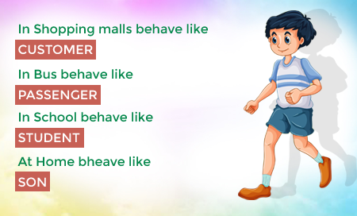



Polymorphism
Polymorphism: It is a Greek term means, “One name many Forms”
Polymorphism
Poly:
Many
Morphism:
Types
Most important concept of object oriented programming
In OOP, Polymorphism is the ability of an object to take on many forms.

Slide 48
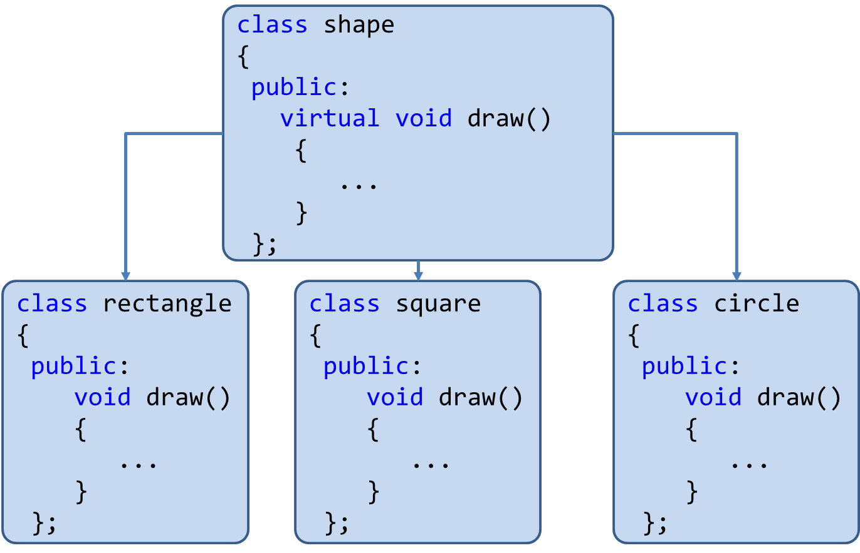
Polymorphism
Polymorphism is the method in an object-oriented programming language that does different things depending on the class of the object which calls it.
Polymorphism can be implemented using the concept of overloading and overriding.

Slide 49
Polymorphism: Advantages
Single variable can be used to store multiple data types.
Easy to debug the codes.
It allows to perform a single act in different ways.
Polymorphism allows the object to decide which form of the function to implement at compile-time (overloading) as well as run-time (overriding).
Reduces coupling, increases reusability and makes code easier to read.

Slide 50
Implementing Polymorphism
Polymorphism
Using
Method Overloading
Using
Method Overriding

Slide 51
Implementing Polymorphism
Overloading & Overriding

Slide 52
Implementing Polymorphism
Polymorphism
Using
Method Overloading
Using
Method Overriding

Slide 53
Method Overloading

Slide 54
Method Overloading: Compile-time Polymorphism
Definition: When two or more methods are implemented that share same name but different parameter(s), the methods are said to be overloaded, and the process is referred to as method overloading
Method overloading is one of the ways that Java implements polymorphism.
When an overloaded method is invoked, Java uses the type and/or number of arguments as its guide to determine which version of the overloaded method to actually call.
E.g. public void draw()
public void draw(int height, int width)
public void draw(int radius)
Thus, overloaded methods must differ in the type and/or number of their parameters.
While in overloaded methods with different return types and same name & parameter are not allowed ,as the return type alone is insufficient for the compiler to distinguish two versions of a method.

Slide 55
Method Overloading: Compile-time Polymorphism
class OverloadDemo{
public static void main(String[] args){
Addition a1= new Addition();
//call all versions of add()
a1.add(20);
a1.add(30,50);
a1.add(10,30,60);
}
}
class Addition{
int i,j,k;
void add(int a){
i=a;
System.out.println("add i="+i);
}
void add(int a,int b){\\overloaded add()
i=a;
j=b;
System.out.println("add i+j="+(i+j));
}
void add(int a,int b,int c){\\overloaded add()
i=a;
j=b;
k=c;
System.out.println("add i+j+k="+(i+j+k));
}
}
Output
add i=20
add i+j=80
add i+j+k=100

Slide 56
Method Overriding

Slide 57
Method Overriding: Run-time Polymorphism
In a class hierarchy, when a method in a subclass has the same name and type signature as a method in its superclass, then the method in the subclass is said to override the method in the superclass.
Definition: If subclass (child class) has the same method as declared in the parent class, it is known as method overriding in Java.

Slide 58
Method Overriding: OverrideDemo.java
class OverrideDemo{
public static void main(String[] args) {
Circle c= new Circle();
c.draw(); //child class meth()
Square sq= new Square();
sq.draw();//child class meth()
Shape sh= new Shape();
sh.draw();//parentClass meth()
}
}
class Shape{
void draw(){
System.out.println("Draw Shape");
}
}
class Circle extends Shape{
void draw(){
System.out.println("Draw Circle");
}
}
class Square extends Shape{
void draw(){
System.out.println("Draw Square");
}
}
When an overridden method is called from within a subclass, it will always refer to the version of that method defined by the subclass. The version of the method defined by the superclass will be hidden.
Output
Draw Circle
Draw Square
Draw Shape

Slide 59
Method Overriding: OverrideDemo.java
class OverrideDemo{
public static void main(String[] args) {
Circle c= new Circle();
c.draw();
Square sq= new Square();
sq.draw();
}
}
class Shape{
void draw(){
System.out.println("Draw Shape");
}
}
class Circle extends Shape{
void draw(){
System.out.println("Draw Circle");
}
}
class Square extends Shape{
void draw(){
System.out.println("Draw Square");
}
}
super.draw();
Here, super.draw( ) calls the superclass version of draw( ).
Output
Draw Shape
Draw Circle
Draw Square
Overridden methods in Java are similar to virtual functions in C++ and C#.

Slide 60
Why Overriding?
Method overriding is used to provide the specific implementation of a method which is already provided by its superclass.
Method overriding is used for runtime polymorphism.
By combining inheritance with overridden methods, a superclass can define the general form of the methods that will be used by all of its subclasses.
Dynamic, run-time polymorphism is one of the most powerful mechanisms that object-oriented design brings to bear on code reuse and robustness.

Slide 61
Method Overriding: Points to remember
Method overriding occurs only when the names and the type signatures of the two methods are identical. If they are not, then the two methods are simply overloaded.
The method must have the same name as in the parent class
The method must have the same parameter as in the parent class.
There must be an IS-A relationship (inheritance).

Slide 62
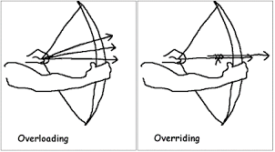
Overloading vs Overriding

Slide 63
Overloading vs Overriding: Java Methods
Method Overloading | Method Overriding
Overloading: Method with same name different signature | Overriding: Method with same name same signature
Known as Compile-time Polymorphism | Known as Run-time Polymorphism
It is performed within class. | It occurs in two/more classes with IS-A (inheritance) relationship.
Inheritance and method hiding is not involved here. | Here subclass method hides the super class method.

Slide 64
Dynamic Method Dispatch
Dynamic method dispatch is the mechanism by which a call to an overridden method is resolved at run time, rather than compile time.
Dynamic method dispatch is important because this is how Java implements run-time polymorphism.
A
Parent Class
A a = new A(); //object of parent class
B b = new B(); //object of child class
A a = new B();
//Up casting(Dynamic Method Dispatch)
B b= new A();
//Error! Not Allowed
B
Child Class

Slide 65
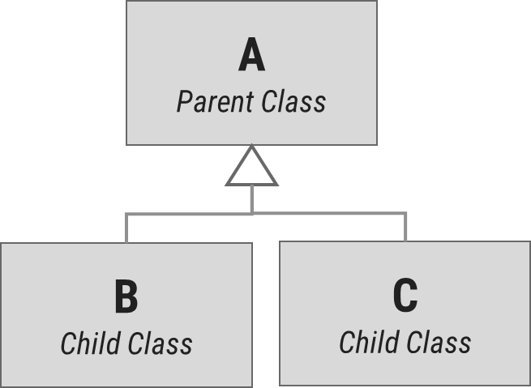
Dynamic Method Dispatch: Example
class A{
void display(){
System.out.println("inside class A");
}
}
class B extends A{
void display(){
System.out.println("inside class B");
}
}
class C extends A{
void display(){
System.out.println("inside class C");
}
}
class DispatchDemo{
public static void main(String[] args) {
A a = new A();
B b = new B();
C c = new C();
A r; //obtain a reference of type A
r=a;
r.display();
r=b;
r.display();
r=c;
r.display();
}
}
Output
inside class A
inside class B
inside class C
Dynamic binding occurs during run-time known as Run-time Polymorphism.

Slide 66
Dynamic Method Dispatch: Example
class Game {
public void type() {
System.out.println("Indoor & outdoor");
}
}
class Cricket extends Game {
public void type() {
System.out.println("outdoor game");
}
}
class Badminton extends Game {
public void type() {
System.out.println("indoor game");
}
}
class Tennis extends Game {
public void type() {
System.out.println("Mix game");
}
}
public class MyProg {
public static void main(String[] args) {
Game g = new Game();
Cricket c = new Cricket();
Badminton b = new Badminton();
Tennis t = new Tennis();
Scanner s = new Scanner(System.in);
System.out.print("Please Enter name of the game = ");
String op = s.nextLine();
if (op.equals("cricket")) {
g = c;
} else if (op.equals("badminton")) {
g = b;
} else if (op.equals("tennis")) {
g = t;
}
g.type();
}
}

Slide 67

Final
The Unmodified Shield!

Slide 68
“final” keyword
The final keyword is used for restriction.
final keyword can be used in many context
Final can be:
Variable
If you make any variable as final, you cannot change the value of final variable(It will be constant).
Method
If you make any method as final, you cannot override it.
Class
If you make any class as final, you cannot extend it.

Slide 69
1) “final” as a variable
Can not change the value of final variable.
public class FinalDemo {
final int speedlimit=90;//final variable
void run(){
speedlimit=400;
}
public static void main(String args[]){
FinalDemo obj=new FinalDemo();
obj.run();
}
}
final

Slide 70
2) “final” as a method
If you make any method as final, you cannot override it.
class BikeClass{
final void run(){
System.out.println("Running Bike");
}
}
class Pulsar extends BikeClass{
void run(){
System.out.println("Running Pulsar");
}
public static void main(String args[]){
Pulsar p= new Pulsar();
p.run();
}
}
final

Slide 71
3) “final” as a Class
If you make any class as final, you cannot extend it.
final
final class BikeClass{
void run(){
System.out.println("Running Bike");
}
}
class Pulsar extends BikeClass
{
void run(){
System.out.println("Running Pulsar");
}
public static void main(String args[]){
Pulsar p= new Pulsar();
p.run();
}
}

Slide 72
Abstraction

Slide 73


Abstraction
Data abstraction is also termed as information hiding.
Abstraction is the concept of object-oriented programming that “represents” only essential attributes and “hides” unnecessary information.
Abstraction is all about representing the simplified view and avoid complexity of the system.
It only shows the data which is relevant to the user.
In object-oriented programming, it can be implemented using Abstract Class.
Advantage:
It reduces programming complexity.
Example:
A car is viewed as a car rather than its
numerous individual components.

Slide 74
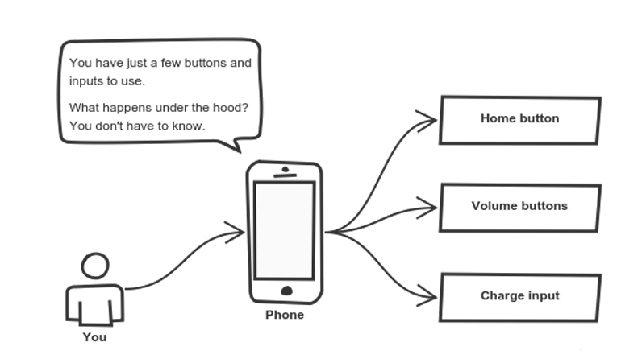
Abstraction

Slide 75
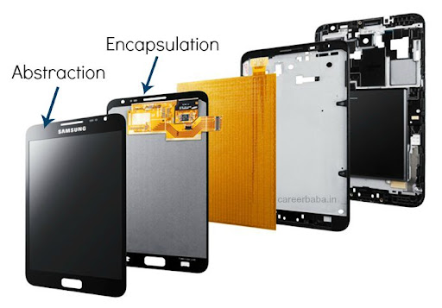
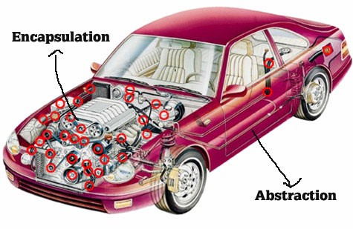
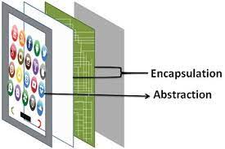
Abstraction vs. Encapsulation
Abstraction | Encapsulation
It means act of removing/ withdrawing something unnecessary. | It is act of binding code and data together and keep the data secure from outside interference.
Applied at Designing stage. | Applied at Implementation stage.
E.g. Interface and Abstract Class | E.g. Access Modifier (public, protected, private)
Purpose: Reduce code complexity | Purpose: Data protection

Slide 76
Implementing Abstraction

Slide 77
Abstract class

Slide 78

Abstract class
Abstraction is a process of hiding the implementation details from the user, only the functionality will be provided to the user.
In other words, the user will have the information on what the object does instead of how the object will do it.
Abstraction is achieved using Abstract classes and interfaces.
A class which contains the abstract keyword in its declaration is known as abstract class.
Abstract classes may or may not contain abstract methods, i.e., methods without body ( public void get(); )
But, if a class has at least one abstract method, then the class must be declared abstract.
If a class is declared abstract, it cannot be instantiated.
To use an abstract class, we have to inherit it to another class and provide implementations of the abstract methods in it.

Slide 79
Abstract class (Example)
abstract class Car {
public abstract double getAverage();
}
class Swift extends Car{
public double getAverage(){
return 22.5;
}
}
class Baleno extends Car{
public double getAverage(){
return 23.2;
}
}
public class MyAbstractDemo{
public static void main(String ar[]){
Swift s = new Swift();
Baleno b = new Baleno();
System.out.println(s.getAverage());
System.out.println(b.getAverage());
}
}
Output
22.5
23.2

Slide 80
Why Abstract Class?
Sometimes, we need to define a superclass that declares the structure of a given abstraction without providing a complete implementation.
The superclass will only define a generalized form, that will be shared by all the subclasses.
The subclasses will fill the details of every method.
When a superclass is unable to create a meaningful implementation for a method.

Slide 81
Points to remember for Abstract Class
To declare a class abstract, you simply use the abstract keyword in front of the class keyword at the beginning of the class declaration.
There can be no objects of an abstract class. That is, an abstract class cannot be directly instantiated with the new operator. Such objects would be useless, because an abstract class is not fully defined.
Cannot declare abstract constructors, or abstract static methods.
Any subclass of an abstract class must either implement all of the abstract methods in the superclass, or be itself declared abstract.

Slide 82

Interface
What to do, not how to do!

Slide 83
Interface
Definition: “Interfaces are syntactically similar to classes, but they lack instance variables, and their methods are declared without any body.”
An interface is similar to an abstract class with the following exceptions
All methods defined in an interface are abstract.
Interfaces doesn’t contain any logical implementation
Interfaces cannot contain instance variables. However, they can contain public static final variables (ie. constant class variables)
Interfaces are declared using the "interface" keyword
Interfaces are more abstract than abstract classes
Interfaces are implemented by classes using the "implements" keyword.

Slide 84
Interface:Syntax
public or not used(default)
access interface name
{
return-type method-name1(parameter-list);
return-type method-name2(parameter-list);
type final-varname1 = value;
type final-varname2 = value;
// ...
return-type method-nameN(parameter-list);
type final-varnameN = value;
}
Methods are without body(no implementation) and all methods are implicitly abstract.
implicitly final and static, cannot be changed by the implementing class, must
be initialized with a constant value.

Slide 85
Implementing Interfaces
Once an interface has been defined, one or more classes can implement that interface.
To implement an interface, include the implements clause in a class definition, and then create the methods defined by that interface.
access interface name
{
return-type method-name1(parameter-list);
type final-varname1 = value;
}
access class classname
[extends superclass]
[implements interface [,interface...]] {
// class-body
}

Slide 86
Interface (Example)
interface VehicleInterface {
int a = 10;
public void turnLeft();
public void turnRight();
public void accelerate();
public void slowDown();
}
class CarClass implements VehicleInterface
{
public void turnLeft() {
System.out.println("Left");
}
public void turnRight() {
System.out.println("Right");
}
public void accelerate() {
System.out.println("Speed");
}
public void slowDown() {
System.out.println(“Brake");
}
}
Here access specifier of method must be public
public class DemoInterface{
public static void main(String[] a)
{
CarClass c = new CarClass();
c.turnLeft();
}
}
Variable in interface are by default
public, static, final
We have to provide implementation to all the methods of the interface
Output
Left

Slide 87
Interface (Example)
interface VehicleInterface {
int a = 10;
public void turnLeft();
public void turnRight();
public void accelerate();
public void slowDown();
}
class CarClass implements VehicleInterface
{
public void turnLeft() {
System.out.println("Left");
}
public void turnRight() {
System.out.println("Right");
}
public void accelerate() {
System.out.println("Speed");
}
public void slowDown() {
System.out.println(“Brake");
}
}
public class DemoInterface{
public static void main(String[] a)
{
c = new CarClass();
c.turnLeft();
}
}
VehicleInterface
CarClass
variable c is declared to be of the interface type VehicleInterface, yet it was
assigned an instance of CarClass.
Output
Left

Slide 88
Interface: Partial Implementations
If a class includes an interface but does not fully implement the methods defined by that interface, then that class must be declared as abstract.
interface VehicleInterface {
int a = 10;
public void turnLeft();
public void turnRight();
public void accelerate();
public void slowDown();
}
abstract
class CarClass implements VehicleInterface
{
public void turnLeft() {
System.out.println("Left");
}
public void turnRight() {
System.out.println("Right");
}
}
public class DemoInterface{
public static void main(String[] a)
{
CarClass c = new CarClass();
c.turnLeft();
}
}
Either class need to implement all the methods of Interface or declare that class as abstract if partial implementation is required.
public void accelerate() {
System.out.println("Speed");
}
public void slowDown() {
System.out.println(“Brake");
}

Slide 89
Interface:Example
class CreateStack implements StackIntf{
int mystack[];
int tos;
CreateStack(int size){
mystack= new int[size];
tos=-1;
}
public void push(int p){
if(tos==mystack.length-1){
System.out.println("StackOverflow");
}
else{
mystack[++tos]=p;
}
}
public int pop(){
if(tos<0){
System.out.println("StackUnderflow");
return 0;
}
else return mystack[tos--];
}
}
interface StackIntf{
public void
push(int p);
public int pop();
}
StackDemo.java

Slide 90
Interface: Example StackDemo.java
class StackDemo{
public static void main(String[] args) {
CreateStack cs1= new CreateStack(5);
CreateStack cs2= new CreateStack(8);
for(int i=0;i<5;i++)
cs1.push(i);
for(int i=0;i<8;i++)
cs2.push(i);
System.out.println("MyStack1=");
for(int i=0;i<5;i++)
System.out.println(cs1.pop());
System.out.println("MyStack2=");
for(int i=0;i<8;i++)
System.out.println(cs2.pop());
}
}

Slide 91
Interfaces Can Be Extended
One interface can inherit another by use of the keyword extends.
The syntax is the same as for inheriting classes.
When a class implements an interface that inherits another interface, it must provide implementations for all methods defined within the interface inheritance chain.

Slide 92
InterfaceHierarchy.java
class MyClass1 implements B{
public void method1(){
System.out.println("inside MyClass1:method1()");}
public void method2(){
System.out.println("inside MyClass1:method2()");
}
public void method3(){
System.out.println("inside MyClass1:method3()");
}
}
interface A{
public void method1();
public void method2();
}
interface B extends A{
public void method3();
}
interface C extends A{
public void method4();
}
class InterfaceHierarchy{
public static void main
(String[] args) {
MyClass1 c1=new MyClass1();
MyClass2 c2=new MyClass2();
c1.method1();
c1.method2();
c1.method3();
c2.method1();
c2.method2();
c2.method4();
}
}
class MyClass2 implements C{
public void method1(){
System.out.println("inside MyClass2:method1()");}
public void method2(){
System.out.println("inside MyClass2:method2()");
}
public void method4(){
System.out.println("inside MyClass2:method4()");
}
}

Slide 93
Interface: Points to Remember
Any number of classes can implement an interface.
One class can implement any number of interfaces.
To implement an interface, a class must create the complete set of methods defined by the interface. However, each class is free to determine the details of its own implementation.

Slide 94
Abstract class vs. Interface
Abstract class | Interface
Abstract class doesn't support multiple inheritance. | Interface supports multiple inheritance.
Abstract class can have abstract and non-abstract methods. | Interface can have only abstract methods.
Abstract class can have final, non-final, static and non-static variables. | Interface has only static and final variables.
An abstract class can extend another Java class and implement multiple Java interfaces. | An interface can extend another Java interface only.
A Java abstract class can have class members like private, protected, etc. | Members of a Java interface are public by default.

Slide 95
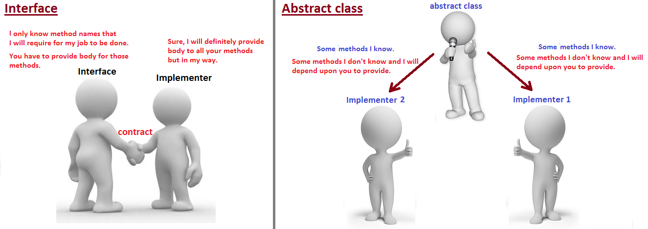
Abstract class vs. Interface
Notes:
Image Reference: https://javabypatel.blogspot.com/2017/07/abstract-class-vs-interface-in-java.html

Slide 96
Thank You

